Slide 1


Analyzing and Predicting Airbnb Listing Price
Presented by: Team 6
Aishwarya V
Ishan Gupta
Bhavika Patel
Sushmita Kalidasu
Srishti Jain
Mentor: Ankush Bansal

Slide 2

Project Overview
About the dataset
Exploratory Data Analysis
Machine Learning Algorithms
Conclusion
Agenda

Slide 3
Project Overview
About AirBNB :
American Co. operates an online market place for vacation rentals and tourism activities.
Problem Statement:
Solution :
Price is an important concern for customer booking online.
Considering Basic Features from listings
eg: Price,Property Types, Neighborhood will be Analyzed and algorithms have used to give the best Accuracy for price.

Slide 4



About the Dataset
Listings
There are 22,552 rows and 96 columns present in the dataset
Columns
Each listing comprises information about the property type, accommodates, location, number of accommodated guests, types of hosts etc.
Source
Kaggle was used to fetch Airbnb-Berlin Data
https://www.kaggle.com/brittabettendorf/berlin-airbnb-data

Slide 5
Exploratory Data Analysis
Outlier Analysis and Treatment
Using Box plot and then treating the outlier values by IQR methodology
Missing Values Treatment
Using isnull() method, we dropped columns more than 65% null values from the dataset that were not relevant to the dataset such as scrape_id, host_neighbourhood etc.
Checked Skewness
Majority of the columns were highly skewed, so we replaced the null values with median
Checked Multicollinearity using VIF for numerical variables
Majority of the columns were dropped such as - host_total_listings_count, review_scores_rating, review_scores_cleanliness and review_scores_location, which decreased the r2 score and rmse
Removed irrelevant categorical data
After treating the outliers, missing values, removing multicollinearity and categorical data, we have 20,122 rows and 24 columns left

Slide 6
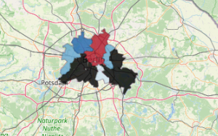
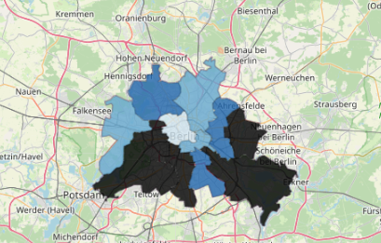
Exploratory Data Analysis
Geospatial Analysis on Neighborhood
Library Used - FOLIUM
The location of each and every Airbnb from the center and its price will be analyzed and plotted depending on different elements :
Mean Price
Median Price
There are outliers present when we compare the median price to mean and centre seems to have costlier apartments

Slide 7
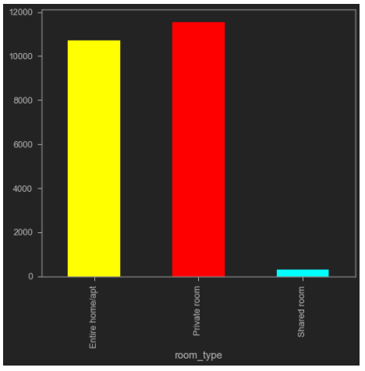
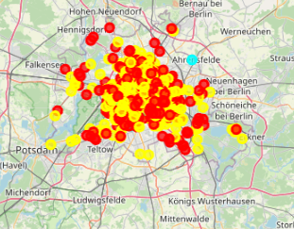
Entire Apartment
Private Room
Shared Room
Exploratory Data Analysis
Geospatial Analysis on Room Type
By Plotting Bar Graph:
By Plotting Heatmap :
Observation : Few shared airbnbs are present which proportionally indicate higher rates(as private rooms and entire apts tend to be pricier) while the map shows the concentration off all the apartments

Slide 8
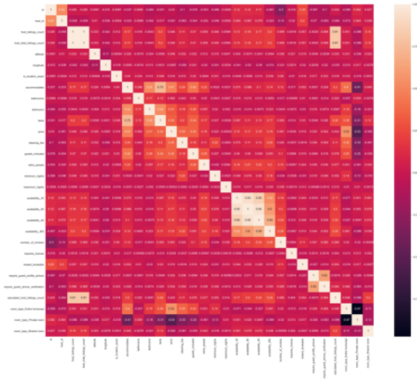
Exploratory Data Analysis
Scaling the data
Using Standard Scaler function
It basically helps to normalize the data within a particular range
Heatmap for correlation between dependent and Independent Variables

Slide 9
Machine Learning Algorithms
Linear Regression Model
Reason for use
Advantage
Disadvantage
Regression analysis is more versatile and has wide applicability.
Regression Analysis is easier to communicate.
Learning Regression Analysis will give you a better understanding of statistical inference overall.
Linear regression performs exceptionally well for linearly separable data.
If one can actually do it accurately, fast and secretly for as long as the market assumptions stay stationary, one will get appropriate price and he/she can enjoy the stay.
Practically impossible to do, if new travel and stay apps with a better pricing (discounts)come into market.
In this Highly competitive field any relevant insights will be made in private space.
It will work only till other competitors are with higher price and no more modifications are done to the data this may lead to overfitting.

Slide 10
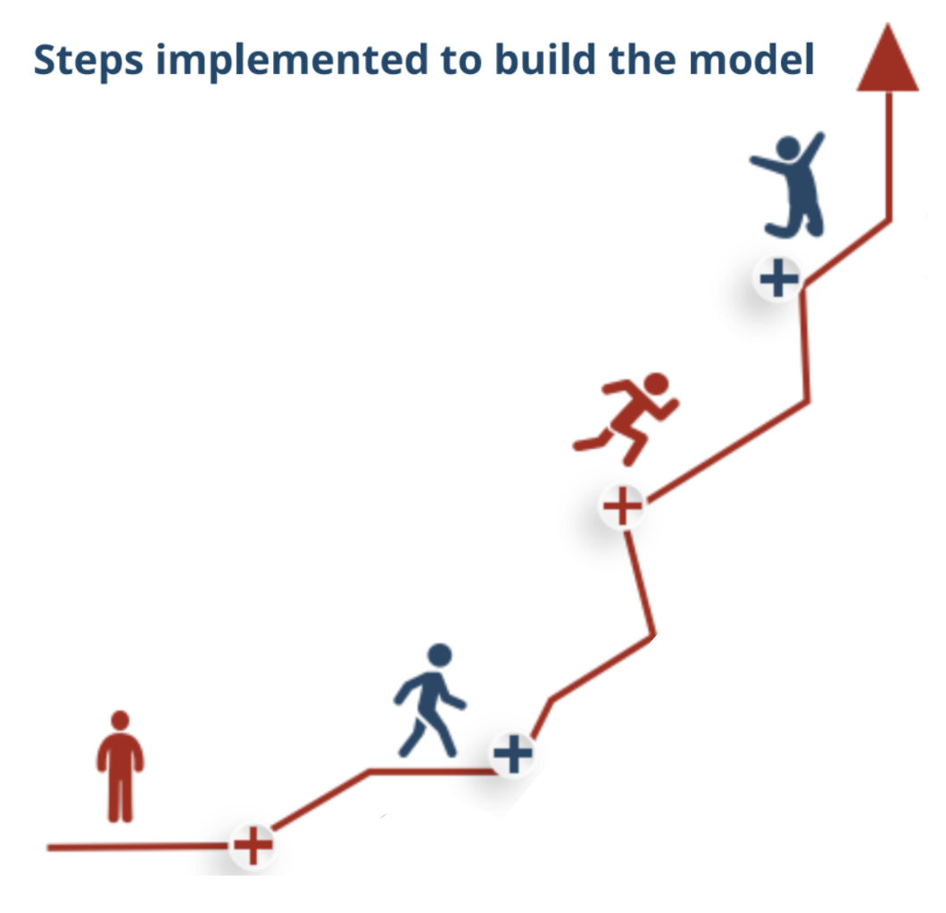
Machine Learning Algorithms
8. To increase r2 and rmse score we also implemented XGBoost
7. Implementing Linear regression models, RFE and Ridge and Lasso using Grid Search CV
6. Create - train and test the model
5. Scaling of features to achieve data using StandardScaler technique
4. Identifying correlation of all features with the dependent variable and Checking multicollinearity
3. Using LabelEncoder for Categorical values
2. Filtering the dataset using Missing Values and Outlier values Treatment; Remove unnecessary columns
Import Packages

Slide 11
Recursive Feature Elimination (RFE)
RFE helps in effectively selecting those features (columns) in a training dataset that are more or most relevant in predicting the target variable.
Below mentioned are the 5 variables that highly impact the target variable - Price
Bedrooms
Guests_included
Require_guest_phone_verification
Reviews_per_month
Room_type_Private room

Slide 12
Other Machine Learning Algorithms
01
Linear Regression Model
R2 Score : 0.47
02
Ridge using Grid Search CV
R2 Score : 0.38
03
R2 Score : 0.42
Lasso using Grid Search CV
04
Random Forest Regressor
R2 Score : 0.57

Slide 13
SOLUTION
CONCLUSION
How to Increase Pricing.
Extra parking space can be given
Complimentary breakfast.
If a host appears more than once, then discounts can be provided
Basic toiletries.
Using Linear Regression algorithms; we were able to predict the target variable with an accuracy of - 67% to 68%
The factors that decide Airbnb rent in Berlin are:
Bedrooms
Guests_included
Require_guest_phone_verification
Reviews_per_month
Room_type_Private room
FUTURE WORK
Use natural language processing to extract more information for better results

Slide 14
Thank You!

